Slide 1
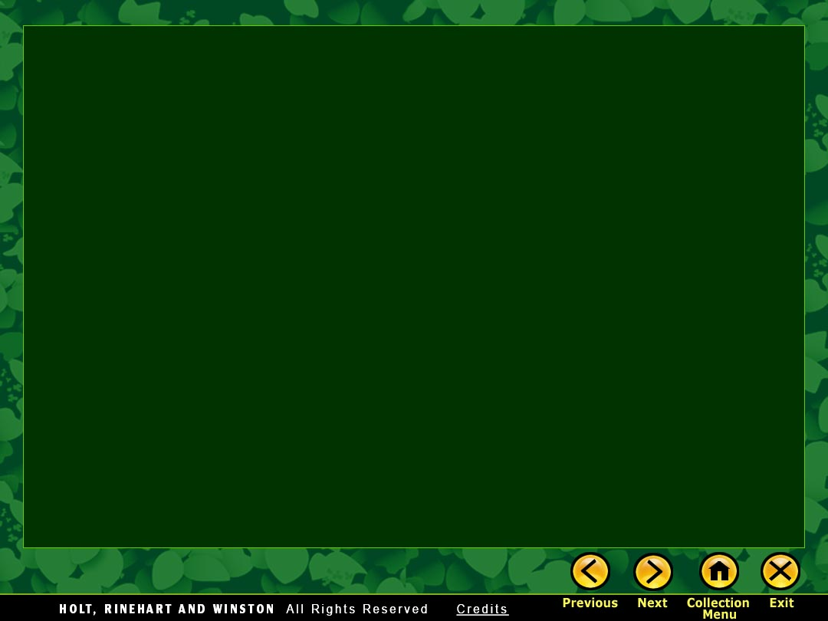
Setting

Slide 2
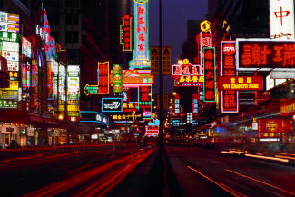
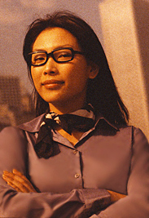
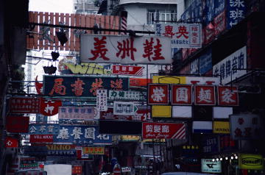
Setting
Setting is the time and place of a story. Setting can include
the locale of a story
people’s customs—how they live, dress, eat, and behave
Hong Kong

Slide 3
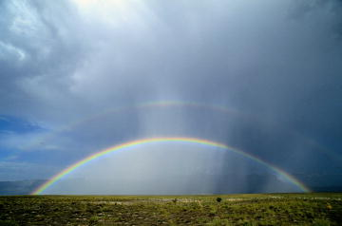
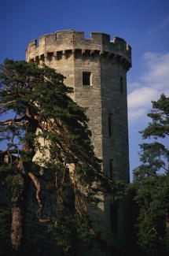
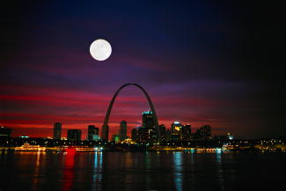
Setting
Setting is the time and place of a story. Setting can include the
weather
time of day
time period (past, present, or future)

Slide 4
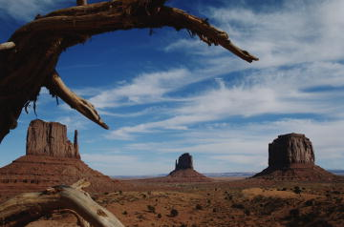
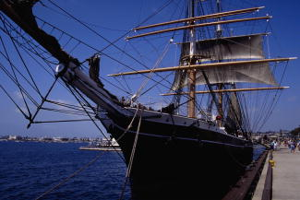
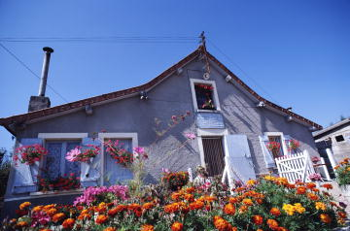
Setting
Setting provides a background—a place where the characters live and act.
[End of Section]

Slide 5
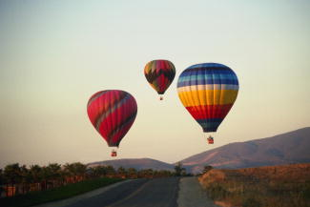
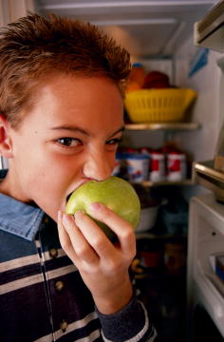
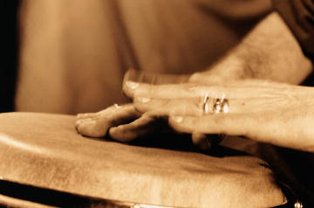
How Is Setting Created?
Writers carefully select images and details to create a setting that draws us into the story.
sight
taste
hearing
three hot-air balloons colored the sky
the steady beat of the drum
the tart apple

Slide 6

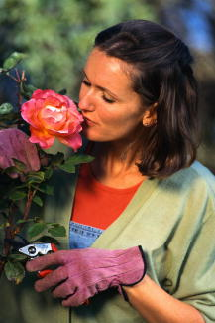
How Is Setting Created?
touch
smell
gritty, wet sand between her toes
strong, sweet scent of a rose
[End of Section]

Slide 7
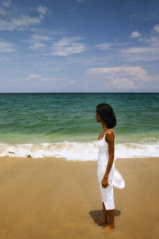
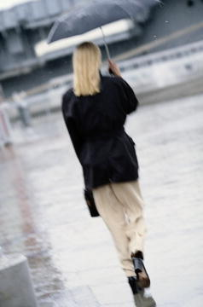
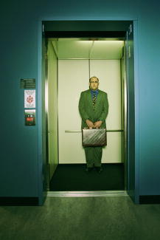
Setting and Character
Sometimes writers place characters in settings that reflect the characters’ personalities.
What do you think these characters are like?
[End of Section]

Slide 8

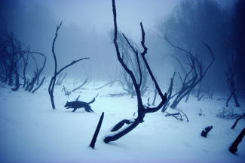

Setting, Mood, and Tone
Setting can also create mood, or atmosphere. It can affect the way we feel about the characters.
peaceful
mysterious
menacing

Slide 9
Setting, Mood, and Tone
Setting can also express a tone, or attitude toward a subject or object.
What is the tone of this passage? How do you think the writer feels about these characters?
Now, with supper finished, we retire to the room in a faraway part of the house where my friend sleeps in a scrap-quilt-covered iron bed painted rose pink, her favorite color. Silently, wallowing in the pleasures of conspiracy, we take the bead purse from its secret place and spill its contents on the scrap quilt.
from “A Christmas Memory” by Truman Capote
[End of Section]

Slide 10

The End

